Slide 1
UIU Eatery -Cafeteria Management System-

Slide 2
Taiyaba Taskin ID: 011162063
Shifa Chowdhury Iwase ID: 011183003
Md. Jubayer Hossain Sheebly ID:011183017
Md Tarifuzzaman ID: 011191245
Md Sazzad Mazumder ID: 011201285
Our Team

Slide 3
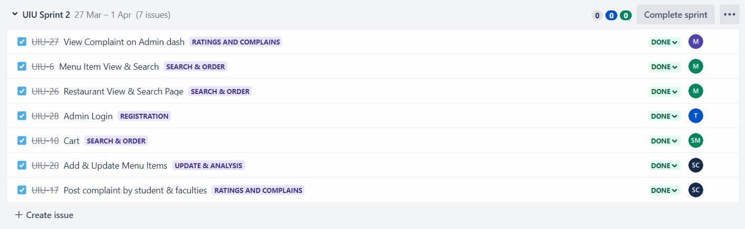
Jira Sprint Cycle - 2

Slide 4
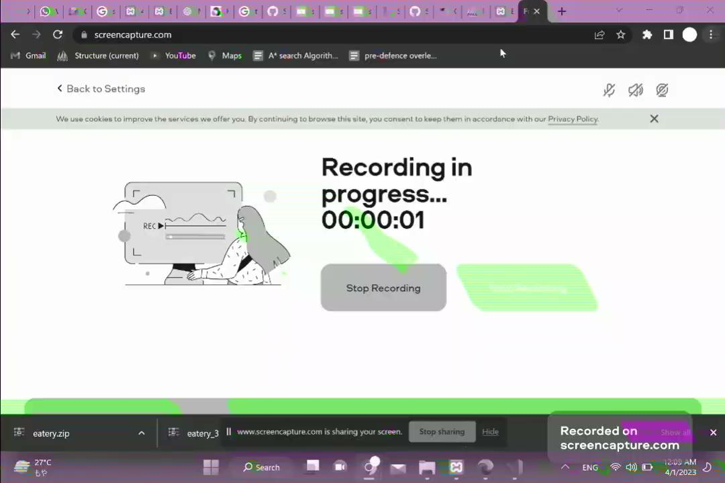
Project Demo

Slide 5
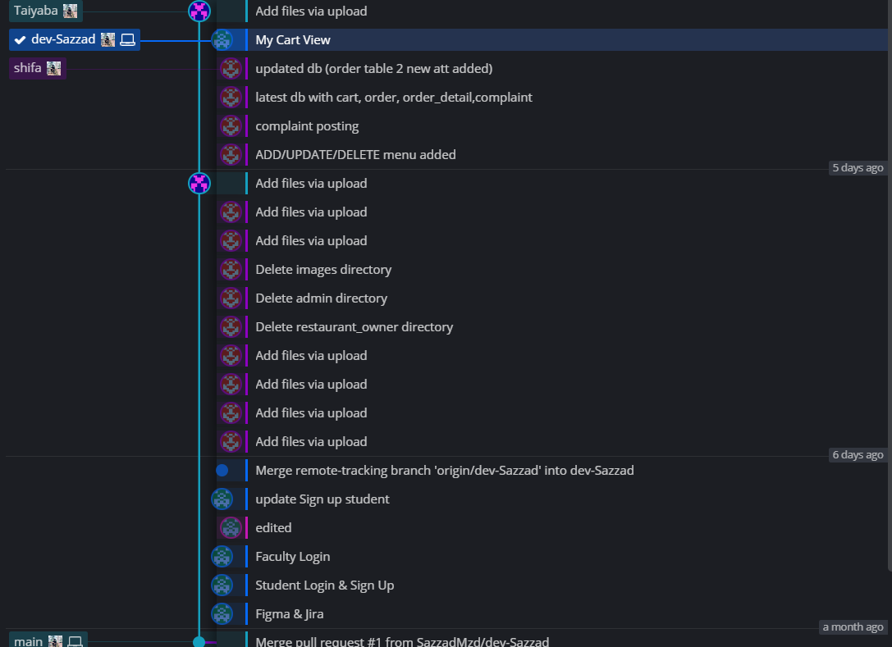
Git

Slide 6
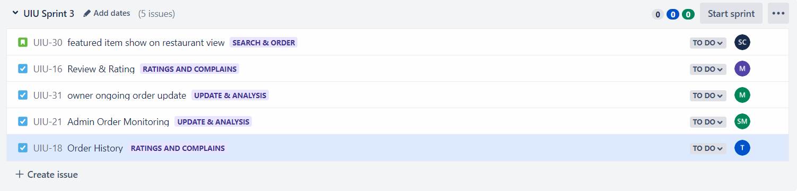
Jira Sprint Cycle - 3

Slide 7
THANK YOU !

